Slide 1
Elements of Gothic Literature (Gothic fiction)
Ms. Galo
November, 2015

Slide 2
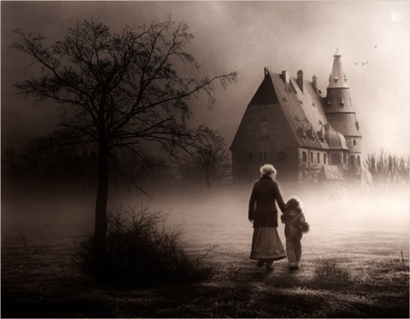
Warm-up
https://www.youtube.com/watch?v=6vtsKGzGVK4
Tell me about the music you heard as you entered the classroom. How did it make you feel? Think mood/tone (you can make a list, summary, or even a short poem if you would like. You can be creative!)
2. Describe the photograph in full detail. What is the setting like? Lighting, shapes, potential inhabitants. How could this photograph potentially influence other artists, writers, and society? What may have been the photographers influence?
**Copy down homework into your agenda & turn in any late or completed assignments.**

Slide 3
What is gothic literature?
Gothic literature began in England in the late 1700s and early 1800s. (18th and 19th century)
It spread to other parts of the world, especially the U.S., where it influenced writers like Edgar Allan Poe →

Slide 4
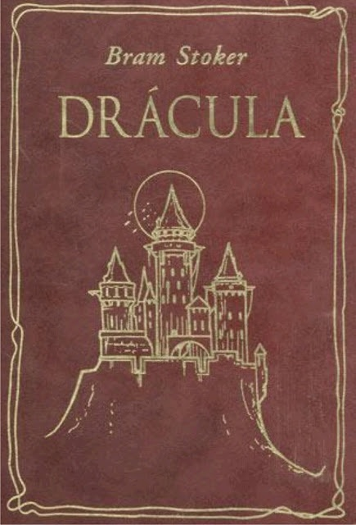
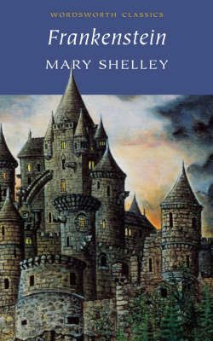
What is gothic literature? (cont.)
It is often grouped with Romantic literature and CAN be romantic, but it explores darker and more tragic themes than other Romantic works of the period.
This genre is rebellious. Gothic literature was and is used to reveal the fears, hatred, and reality that exists within society.

Slide 5
Elements of Gothic Literature
There are a number of specific qualities that make gothic fiction literature different from other types of literature.
The following is what I consider the 8 most important elements; You may NOT find ALL of these elements in a Gothic piece of literature but many will be present.

Slide 6
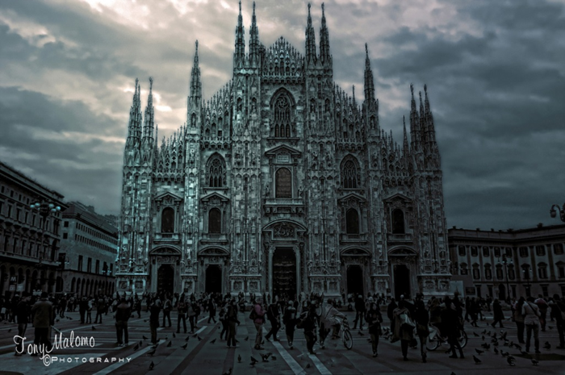
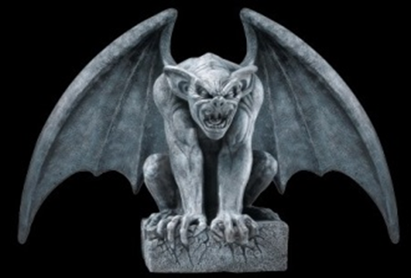
#1 Setting (Part 1)
•Gothic literature often is set in old, rundown structures, especially: castles, cathedrals, other large neglected homes (like mansions).
•These buildings generally include hidden passages, trap doors, dungeons, or secret rooms.
•rundown, falling apart, or has been abandoned for a long time.

Slide 7
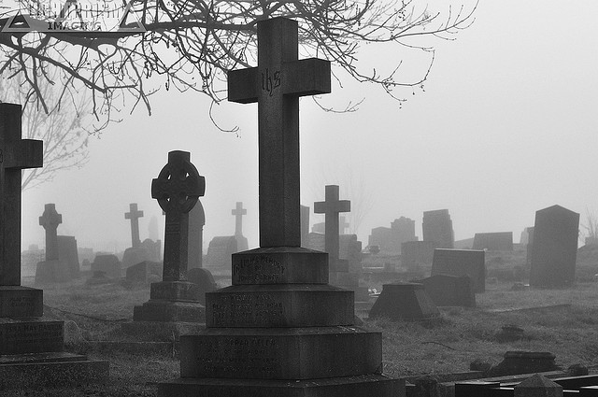
#1: environment (setting part 2)
The environment around the setting is a dangerous or exposed atmosphere.
Generally there are dark forests, large mountains, stormy weather, or areas far away from civilization (areas that are isolated)

Slide 8
#1: Atmosphere (Setting Part 3)
Gothic literature stresses an atmosphere of mystery, horror, and dread. This could also be considered as part of the setting.
This atmosphere is usually enhanced by the “unknown”. Often the plot itself is built around a mystery, such as unknown parentage, a disappearance, or some other inexplicable (unable to explain) event.

Slide 9
#2: An ancient prophecy
What’s an ancient prophecy?
A very old prediction of something that is going to happen.
In Gothic literature, ancient prophecies are usually connected with the old castle, mansion, or estate; or, connected to its present or former inhabitants.
In the “Harry Potter” series, Harry’s parents hide him among humans as a child because of a prophecy that said Harry would grow up to defeat Lord Voldemort.

Slide 10
#3: Supernatural or otherwise inexplicable events
Dramatic events can occur; ghosts walking, nonliving objects move on their own (like a painting coming to life).
In some gothic literature the events in the end, are given a more natural explanation, but sometimes the events remain truly supernatural (of another world/not-living/in spirit)
Here Scrooge is visited by a ghost of his
former business partner, Jacob Marley, in A Christmas Carol.

Slide 11
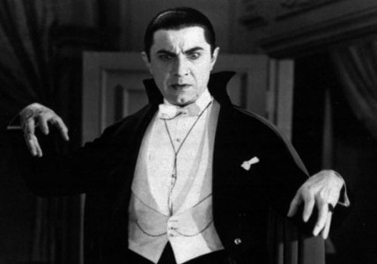
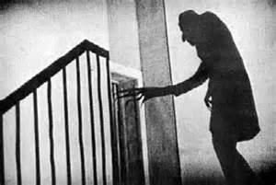
#4 CHARACTERS
What makes an “Gothic” Character?
Reader is suspicious of character (maybe even unreliable. Should we believe what they say? Are they secretive or sneaky?)
Physical deformity or abnormality
Mental Illness
Isolation
Distress
Can be an innocent person
Superstitious (belief in the supernatural or irrational belief based on fear)

Slide 12
#4: characters the isolation of the protagonist
The main characters of the Gothic literature are often isolated or alone.
It could be physical isolation. For instance, the main character could be trapped in a house far away from other people.
It could also be emotional isolation. The main character could be emotionally cut off from the people around her or even mentally ill.
The main character in Daphne DuMaurier’s Rebecca was cut off from the rest of the world with only an evil housekeeper for company.

Slide 13
#5: suspense & drama
The events in Gothic literature usually show high emotion and often reflect a heightened sense of drama. There is usually a SERIES OF UNFORTUNATE EVENTS!
For example, in Gothic literature it is not unusual to see murders, kidnappings, people going mad (crazy), and tragic or mental illness.
Mary Shelley’s Frankenstein is full of drama and a lot of emotion.

Slide 14
#6: Vocabulary
On the right are a list of different adjectives, feelings, or other words that are generally associated with gothic literature.
Words that give a sense of:
Mystery
Terror or Fear
Sadness
Surprise/Suspense
Anger
Darkness
Supernatural
Suspicion
Isolation

Slide 15
#7: Metonymy of gloom and horror
A metonymy is a type of metaphor. Remember a metaphor is a comparison between two things that does not use the words like or as.
A metonymy is a type of metaphor in which something is used to stand for something else. A lot of times in movies, we will see it raining at a funeral. Therefore the rain stands for sadness.
METONYMIES FOR
“gloom and doom”
Wind, especially howling wind
Doors grating on rusty hinges
Footsteps approaching
Lights on in abandoned rooms
Characters trapped in a room
Ruins of a building
Thunder and lightning
Rain, especially blowing

Slide 16
#7 More metonymies for “gloom and dooM”
Shrieks, howls, eerie sounds
Clanking chains
Gusts of wind blowing out lights
Doors suddenly slamming shut
Baying of distant dogs (or wolves)
Crazed laughter
Can you think of any others?

Slide 17
#8 Mood and tone
The Gothic Elements MAKE the MOOD & TONE!
Mood
Mood gives off certain feelings or emotions in readers through words and descriptions.
Mood can be referred to as the atmosphere of a text.
Tone
The attitude that the author has with a specific character, place or development.

Slide 18
Gothic text examples
Classic Gothic Texts
Frankenstein by Mary Shelley
Dracula by Bram Stoker
The Tell-Tale Heart, The Raven, The Pit and the Pendulum, all by Edgar Allan Poe
Are there any others?
Modern Gothic Texts
Can we name some?
The Twilight Saga by Stephenie Meyer
The Harry Potter Series by J.K. Rowling
The Shiver Trilogy by Maggie Stiefvater

Slide 19
HOMEWORK
Please read The Tell-Tale Heart by Edgar Allan Poe tonight.
If you need a paper copy, come see me!
If you have not finished your Gothic Literature Web Quest, please complete for homework!
Share with me: ngalo@uncc.edu

Slide 20
Resources
Pictures and Information
www.predestinarian.net
www.gaiaonline.com
www.nytimes.com
harrypotter.wikia.com
www.reverseshot.com
richeyrich.wordpress.com
http://www.slideserve.com/tiara/elements-of-gothic-literature

