Slide 1
The Tell-Tale Heart
by Edgar Allan Poe

Slide 2
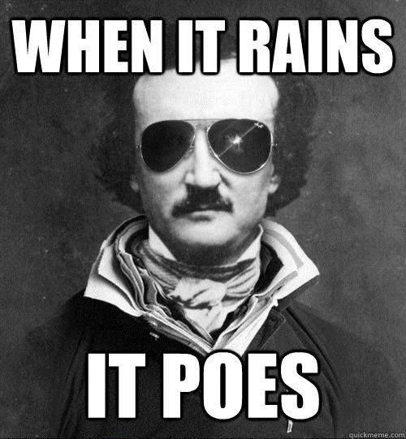
WARM-UP
November 9th, 2015
Write homework in agenda
Get out a writing utensil and a loose-leaf sheet of paper

Slide 3
SUSPENSE
Author Technique
How might an author describe a character’s anxiety or fear?
What vivid words might an author use to describe dramatic sights and sounds?
How might an author use repeating words, phrases or character’s actions to create suspense?
A “hook” is used to create a sense of excitement, tension, dread, or fear about what will happen next.
https://www.youtube.com/watch?v=sluHwh3hJhI

Slide 4
Let’s listen to THE STORY…
Since we read The Tell-Tale Heart for Homework (I hope you did!), let’s listen to the audio version…
During the audio, follow these instructions →
What was the difference in mood/tone when you read the story yourself and when listening to someone else read it?
How does word choice affect mood and tone?
Write a short response as we listen. Turn in to me ☺
https://www.youtube.com/watch?v=nvrG4E4CtZM

Slide 5
Group Activity Example
Passage:
“I heard all things in the heaven and in the earth. I heard many things in hell. How, then, am I mad? Hearken! And observe how healthily—how calmly I can tell you the whole story.”
Key Words:
Heaven, earth, hell; “How, then, am I mad?”
The Mood:
It makes us feel like we are dealing with something supernatural. The feel is crazed, delusional, and mad (crazy).

Slide 6
Group activity
Group Task 1:
Share what you thought was suspenseful in the story for a few minutes. Refer to specific words and events in the text.
Group Task 2:
Complete the mood and tone chart in your groups of 4 & 5.
I will assign each group an excerpt and you will share with the class on how your group came to its conclusion on the key words and the mood.

Slide 7
Socratic seminar question development
Good Socratic Seminar questions are open-ended, catalyze critical and analytical thinking, and are clear. Can you refer to the text with your question? Will it get your classmates thinking?
Examples from The Giver by Lois Lowry
1. What do you think happened at the novel’s conclusion, that was “perhaps … only an echo?” I think it was____________________.
2. Why did Jonas say “We really have to protect people from wrong choices.” at the end of Chapter 13? He just finished protesting the community’s inability to see color. He wanted change. What changed his mind again, so abruptly?

Slide 8
HOMEWORK
Please re-read The Tell-Tale Heart for homework if you need to. You can annotate if it will help you, but it is not required.
Bring in 3 Socratic Seminar Questions tomorrow to talk about during the class discussion.

Slide 9
References
The Tell-Tale Heart by Edgar Allen Poe
https://www.youtube.com/watch?v=sluHwh3hJhI
https://www.youtube.com/watch?v=nvrG4E4CtZM
The Giver by Lois Lowry
http://www.sparknotes.com/lit/giver/quotes.html

