Slide 1
Socratic Seminar
Rules, Expectations, & Goals

Slide 2
Warm-up
Please get out your 3 Socratic Seminar questions you have completed for homework last night. If you can answer your question with a yes or no, REVISE! Good Socratic Seminar questions are always open-ended, require critical and analytical thinking, and are clear. Can you refer to the text with your question? Will it get your classmates thinking?
Work on these questions with a partner for the next 15 minutes…

Slide 3
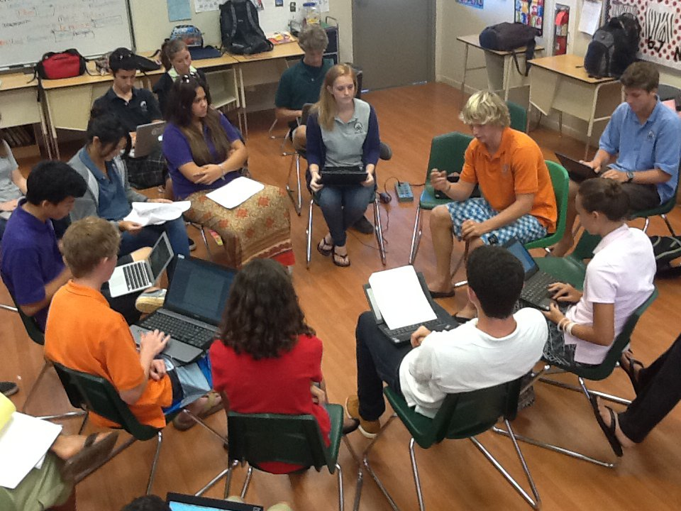
What is a Socratic Seminar?
It is a continuous open discussion between a group of people on a particular topic. Usually participants are in a circle formation so everyone can pay attention to the speaker and hear them clearly.
Everyone, please get out a sheet of paper and make yourself a name card to place on your desk.

Slide 4
RULES & EXPECTATIONS
•You don’t need to raise your hand to talk. You should focus on the main speaker and wait your turn.
•Look at the speaker.
•Speak voluntarily at least twice.
•Project your voice so the class can hear you.
•Refer to the text. (Part of the story? Page #’s?)
•You should respond to each other, using each other’s names.
•You should express agreement or disagreement in a courteous, thoughtful manner.

Slide 5
GROUP GOALS
•Focus on ideas and values in the text.
•Keep an open mind.
•Invite everyone to share their ideas.
•Use others’ names.
•Remember that one person speaks at a time.

Slide 6
References
http://www.paideia.org/socratic-questioning/

