Slide 1
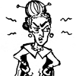
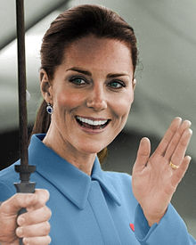
“Her two stepsisters, Drizella and Anastasia, and her stepmother were very cruel.” (2) “How could you go?” they jeered. “You don’t even have a gown to wear.” (3) “But Anastasia and Drizella were angry because Cinderella looked so pretty.” (4) “This is where the Prince fell in love with her.” (6) “The Prince looked everywhere for his beautiful lady, but he could not find her.” (8) “But Cinderella and the Prince were happiest of all. For after that, their loveliest dreams came true- together.” p.10
Rags (4)
Scraps (6)
The evil stepmother was the obstacle that stood in Cinderella’s way of happiness. Stepmother locked Cinderella in a room so that she could not come out and try on the glass slipper. Cinderella had to break free from the room to be with her Prince.
Good will prevail over evil
Cruel (2)
Scrubbed (4)
Jeered (4)
Locked (9)
Broken (6)
Wicked (3)
Dreams (10)
Magic (10)
Real world situation- Kate Middleton was once a victim of merciless bullying in school. She is now married to Prince William and is the current Duchess of Cambridge. Bullying is still a real problem and those who are bullied are inspired by people who come out on top- such as Kate Middleton.
Setting- “Cinderella lived in a splendid house, but she was not happy.” (3)
Although her house was aesthetically appealing, it lacked love and happiness for Cinderella.

